Slide 1
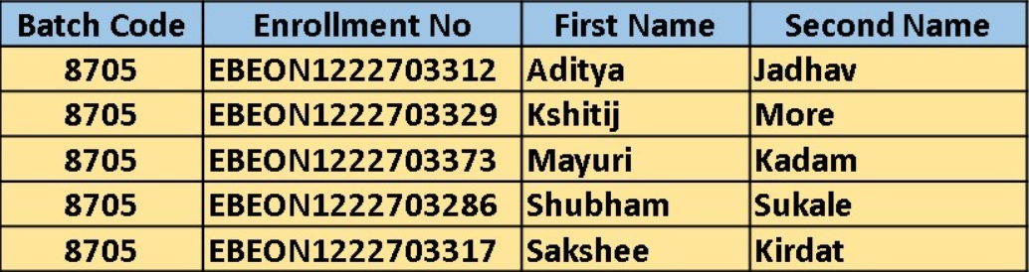
Grocery Delivery Application
Team Leader: Aditya Jadhav
Enrollment No. : EBEON1222703312
Guided by
Varadharajan A Sir

Slide 2
Grocery Delivery Application
Login Module
Admin Module
Home Page
Add to cart/ Order module
View Products module
Payment module
About us, Contact us

Slide 3
Grocery Delivery Application
All Products Module
Display Products on Homepage
All Products Page
2) Product Details View Module
3) Add New Product Module
4) Edit & Remove Product Module

Slide 4
Module 1
All Products Module:
Display All Available Products on Homepage
All Products Page

Slide 5
Module 2
Product Details View Module:
a) Display Image of Product
b) Description
c) Price

Slide 6
Module 3
Add New Product Module :
Input Fields For Each Attribute

Slide 7
Module 4
Edit & Remove Product Module :
a) Edit Button for each product that redirects to Edit Page
b) Remove Button

Slide 8
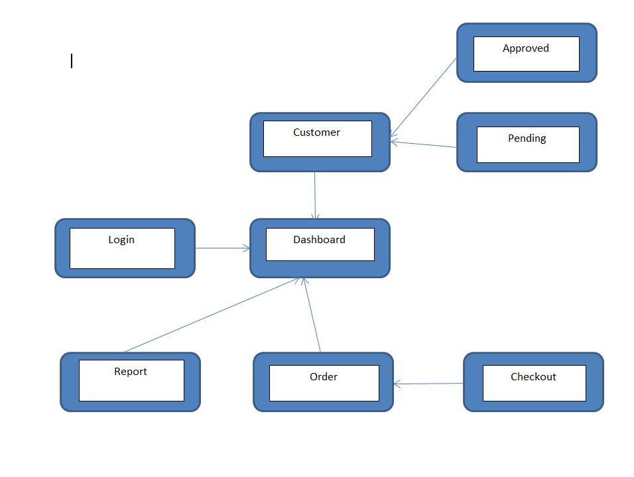
Project overview

Slide 9
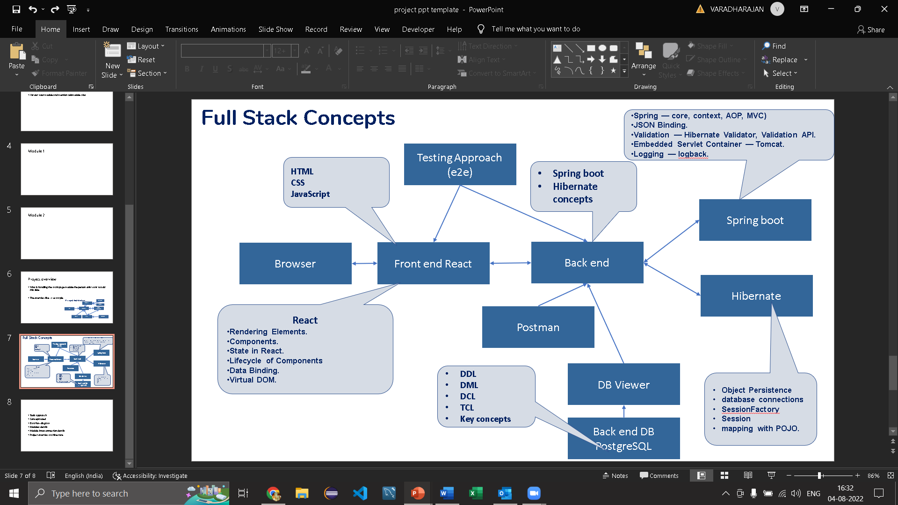
Tech architecture

Slide 10
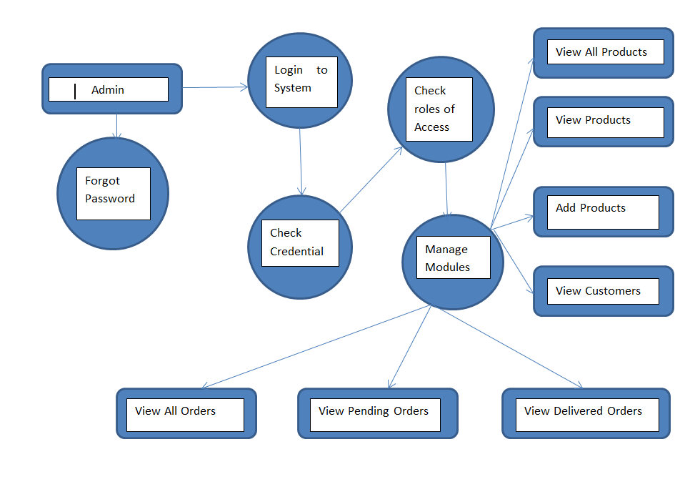
Dataflow diagram

Slide 11
Challenging issues
1) While running project port no. problem
2) wrong dependencies added
3) Changes made in code are not reflected into live project

Slide 12
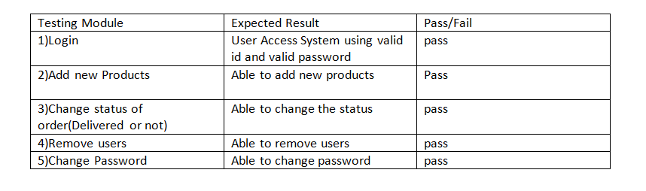
Testing

Slide 13
Future enhancement
Integration with virtual assistants: Integrate the website with virtual assistants like Google Assistant or Amazon Alexa, enabling customers to easily place orders through voice commands.
Smart recommendations: Utilizing data analytics and machine learning techniques to suggest products based on customer’s buying history, browsing history and preferences
Live customer support: Offering live chat support and personalized customer service to ensure customer satisfaction and resolve any issues that may arise.

Slide 14
Conclusion
Online grocery delivery websites are becoming increasingly popular due to their convenience and time-saving features.
This project is made in such a way that it is easy to use/ handle for new users
Person with little technical knowledge can also use/ interact with this project

Slide 15
THANK YOU

